Slide 1
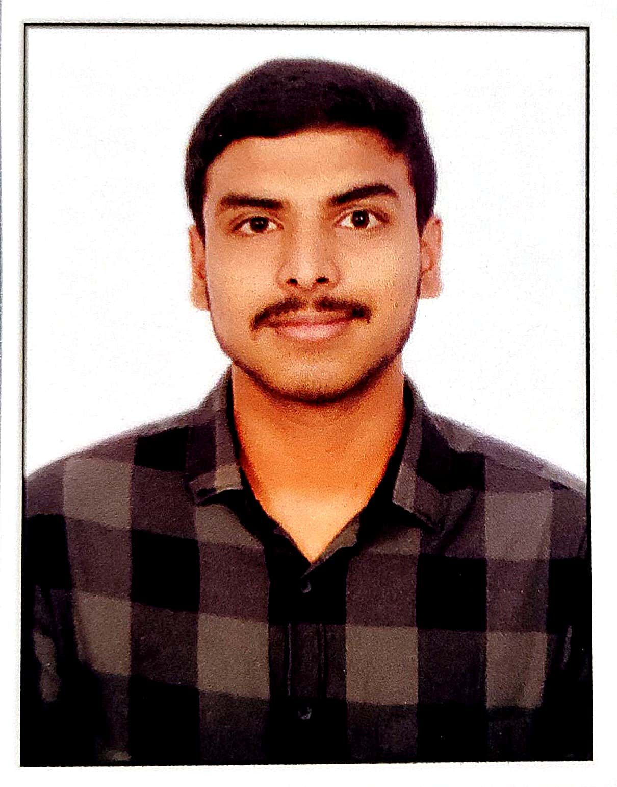
Name: Bhargava Ram Kulla
UST Role: Junior SRE
Location: Hyderabad
Family: Parents and Sister
Total Work Experience: NA
College Project: Bucketing and Partitioning Data to Access Data with Low Latency
Technology courses attended: Programming for Everybody(Python) - Coursera
Professional Certificates : AWS Certified Cloud Practitioner
Professional skill set: Git, Jenkins, Ansible, Kubernetes, Docker, AWS, Python
Hobbies: Cooking, Painting, Playing Badminton and Making Reels
Interest: Listening to Music and Travelling
Have your Picture here

